Slide 1
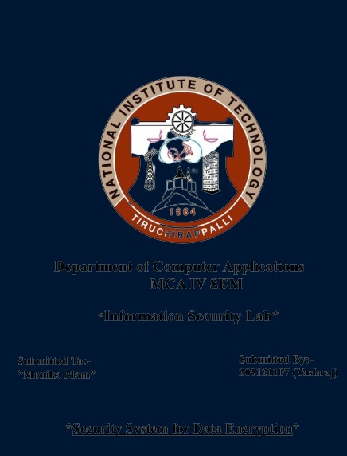


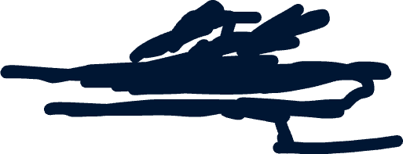




Department of Computer Applications
MCA V SEM
Project Review-I
Submitted To:-
Dr. Balaji Banothu
Submitted By:-
Yashraj (205121107)

Slide 2
Digital Forensic
Deep Analysis Of Digital Evidence

Slide 3
Deep Fake Creation And Detection
Deepfakes Are A Type Of Artificial Intelligence (AI) Technology That Uses Deep Learning Algorithms, Particularly Deep Neural Networks, To Create Realistic-looking Fake Videos, Images, Or Audio Recordings. These Manipulated Media Can Convincingly Depict Individuals Saying Or Doing Things They Never Actually Did. The Term "Deepfake" Is A Portmanteau Of "Deep Learning" And "Fake.”
Deepfakes Are Creating Several Significant Issues, Both Ethical And Practical, As They Become More Advanced And Accessible:
Misinformation And Fake News: Deepfakes Can Be Used To Create Realistic-looking Videos Of Public Figures Saying Or Doing Things They Never Did. This Can Be Exploited To Spread False Information, Manipulate Public Opinion, And Damage Reputations.
Privacy Violations: Deepfakes Are Often Used To Create Non-consensual Pornographic Content By Superimposing An Individual's Face Onto Explicit Material. This Is A Gross Violation Of Privacy And Can Cause Immense Harm To The Victim.
Identity Theft: Deepfakes Can Be Used To Impersonate Individuals, Potentially Leading To Identity Theft Or Fraudulent Activities, Such As Scamming People Or Gaining Unauthorized Access To Accounts Or Systems.

Slide 4
Abstract
Concise Summary Or Brief Overview Of Deep Fake Technology

Slide 5
“Deep learning has been used in A wide range of applications like computer vision, natural language processing and image detection. The advancement in deep learning algorithms in image detection and manipulation has led to the creation of deepfakes, deepfakes use deep learning algorithms to create fake images that are at times very hard to distinguish from real images. With the rising concern around personal privacy and security, many methods to detect deepfake images have emerged, in this paper the use of deep learning for creating as well as detecting deepfakes is explored, this paper also propose the use of deep learning image enhancement method to improve the quality of deepfakes created.”
Deep Learning

Slide 6
01
Introduction

Slide 7
Introduction To Deep Fake Technology
Deepfakes pose a large threat to a future where fake news is everywhere, you could watch a video of an important public figure or president giving a speech and not be sure whether what you are seeing is real or fake, especially because the process of creating these fake images and videos is much simpler today as you only need as little as an image or a video of the target individual to generate the fake content.
The underlying mechanism for deepfake creation is using deep learning encoders and decoders, which have been used extensively in the machine vision domain. The encoders work by extracting all the features in an image and then decoders are used to generate the fake image. Deepfake methods need a large number of images and videos to train the deep learning models, this used to be a hard task but in the time that we live in you could easily find a large dataset of images on social media, this wide availability of data has led to the development of more complicated deepfake techniques, many of deepfake algorithms are designed using TensorFlow.
TensorFlow is an open-source software library for numerical computation using data-flow graphs. It was originally developed by google to be used internally in it research and development of machine learning and deep neural networks.
TensorFlow provides a way to design neural networks quickly with adequate performance and API’s can be used with the python programming language, we can easily change the CNN architecture and test various designs without having to modify many lines of code.

Slide 8

Deep Fake Creation
Deep Fake Is A Portmanteau Of "Deep Learning" And "Fake”

Slide 9
Creation Of Deep Fake Technology
Deepfakes are created using deep learning methods in which they aim to replace the face of a targeted person by the face of someone else in an image or video. This technique was improved by developers and online communities to notably create user-friendly applications that are readily available online like FakeApp and FaceSwap.
Deepfake relies on an autoencoder-decoder pipeline, encoders are widely used in image compression they rely on deep neural networks and by introducing a bottleneck in the network this forces a compressed representation of the original input [12]. As more advanced encoders are introduced, high-quality image compression is possible which can facilitate deepfake task as less computational power is required [13][14]. Deepfake creation work by training two autoencoders.
One autoencoder learns the features of the source image and the second encoder learns the feature the target image and two encoders share their parameters, then to generate the deepfake image, the target image is reconstructed using the source image’s decoder, this will generate an image of the target with features of the source image . this method is the most common way of deepfake image creations and is used by DeepFaceLab and many others. The performance of this method is directly related to the size of the dataset available to train the deep neural network, luckily a huge number of datasets is readily available to the public on the internet in the form of social media, an incredible amount of images and videos is available publicly on Instagram and YouTube, especially for public figures and celebrities and that is exactly why public figures where the first target of deepfakes and are the ones most affected by it. Also, the research community provides many datasets to use in deepfake Eg. Generative Adversarial Networks (Style-GANs),Deepfake_tf (TensorFlow).

Slide 10
Deep Fake Detection
Deep Fake Is A Portmanteau Of "Deep Learning" And "Fake”

Slide 11
Detection Of Deep Fake Technology
To successfully build a robust neural network capable of detecting complex deepfakes a large dataset of training images is needed. due to social media these kind of images can be easily obtained also companies like google provide large datasets to help accelerate the research in protection against deepfakes. MesoNet used a dataset of more than 5000 images , the images are divided into real images and deepfake images.
Generative Adversarial Networks (GANs),After training the CNN with the dataset, the CNN is able to detect deepfake images with over 80 % confidence rate. When exploring current deepfake images available online, deepfake flaws are easily noticeable, deepfake images of a person’s face looking straight ahead to the camera are harder to detect than images where the person’s face is looking at an angle. current deepfake generation techniques aren’t that great at dealing with faces at an angle.
but advanced deepfake generation techniques can sometimes generate images that are very hard to detect from real images, despite using a large dataset, some deepfake images are misclassified as real images Eg. ResNet50 Model

Slide 12
Conclusion
In this paper Deep Fake creation and detection was explored as well as the integration of Deep Learning image enhancement method to increase the quality of deepfakes created. From our experiment, the use of image enhancement methods like DFDNET gave higher-quality look deepfake images, which give them a more genuine look unlike the typically low quality associated with fake images on the internet. Deepfake detection in the case of face-swapping deepfakes, they are hard to detect when the person is facing straight towards to camera, when the person looks to his side, imperfections in the deepfake generated image can be seen. We believe that to further improve the performance of deepfake detectors, the focus should be on using datasets of difficult conditions like this. Our future work will explore generating deepfakes with reduced imperfections and higher quality using image enhancement methods to try and make them harder to detect for deepfake detection methods.

Slide 13
THANKS!
Do you have any questions?
yashjain1nit@gmail.com
+91 8085073043

Slide 14
IMAGE

